Slide 1
Heapsort

Slide 2
Why study Heapsort?
It is a well-known, traditional sorting algorithm you will be expected to know
Heapsort is always O(n log n)
  Quicksort is usually O(n log n) but in the worst case slows to O(n²)
  Quicksort is generally faster, but Heapsort is better in time-critical applications
Heapsort is a really cool algorithm!

Slide 3
What is a “heap”?
Definitions of heap:
  A large area of memory from which the programmer can allocate blocks as needed, and deallocate them (or allow them to be garbage collected) when no longer needed
  A balanced, left-justified binary tree in which no node has a value greater than the value in its parent
These two definitions have little in common
Heapsort uses the second definition

Slide 4
Definitions
Height of a node = the number of edges on the longest simple path from the node down to a leaf
Level of a node = the length of a path from the root to the node
Height of tree = height of root node
4
Height of root = 3
1
3
Height of (2)= 1
2
16
9
10
Level of (10)= 2
14
8

Slide 5
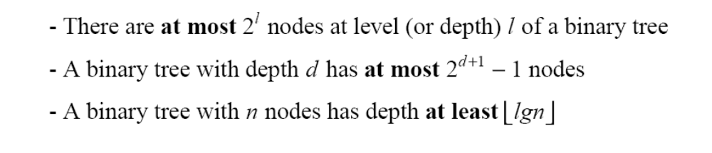
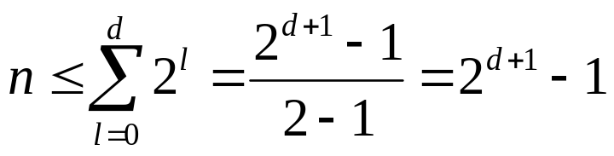
Useful Properties
height
height
4
Height of root = 3
1
3
Height of (2)= 1
2
16
9
10
Level of (10)= 2
14
8

Slide 6
The Heap Data Structure
Def: A heap is a nearly complete binary tree with the following two properties:
  Structural property: all levels are full, except possibly the last one, which is filled from left to right
  Order (heap) property: for any node x
  Parent(x) ≥ x
From the heap property, it follows that:
“The root is the maximum
element of the heap!”
8
7
4
5
2
Heap
A heap is a binary tree that is filled in order

Slide 7
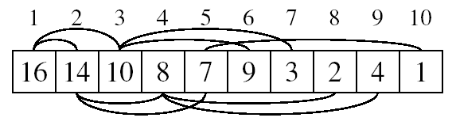
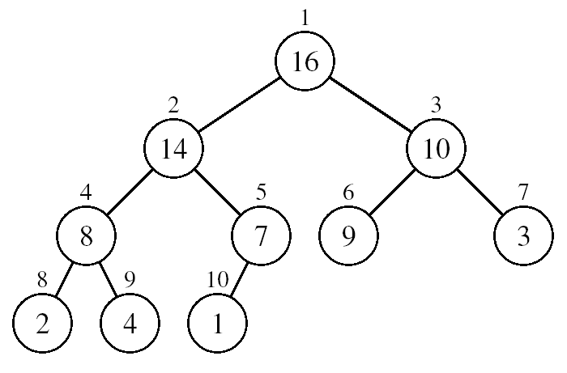
Array Representation of Heaps
A heap can be stored as an array A.
  Root of tree is A[1]
  Left child of A[i] = A[2i]
  Right child of A[i] = A[2i + 1]
  Parent of A[i] = A[ ⎣i/2⎦ ]
  Heapsize[A] ≤ length[A]
The elements in the subarray A[(⎣n/2⎦+1) .. n] are leaves

Slide 8
Heap Types
Max-heaps (largest element at root), have the max-heap property:
  for all nodes i, excluding the root:
  A[PARENT(i)] ≥ A[i]
Min-heaps (smallest element at root), have the min-heap property:
  for all nodes i, excluding the root:
  A[PARENT(i)] ≤ A[i]

Slide 9
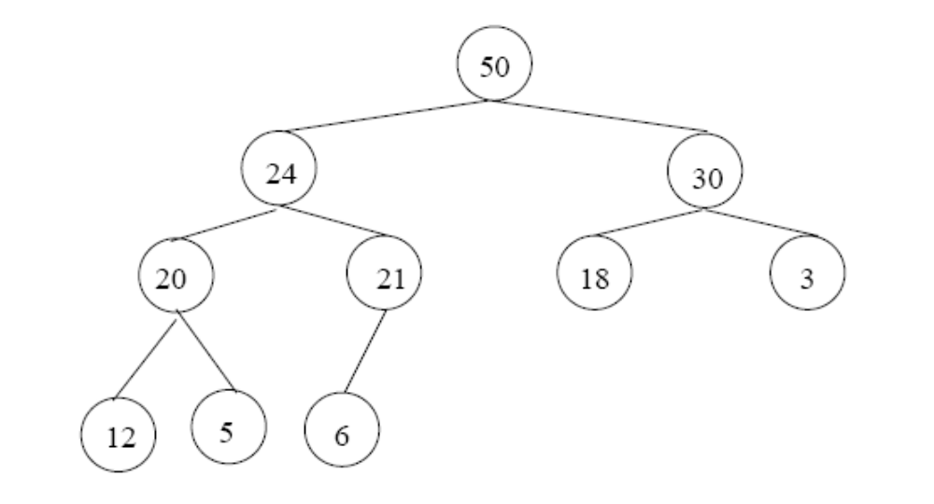
Adding/Deleting Nodes
New nodes are always inserted at the bottom level (left to right)
Nodes are removed from the bottom level (right to left)

Slide 10
Operations on Heaps
Maintain/Restore the max-heap property
  MAX-HEAPIFY
Create a max-heap from an unordered array
  BUILD-MAX-HEAP
Sort an array in place
  HEAPSORT
Priority queues

Slide 11
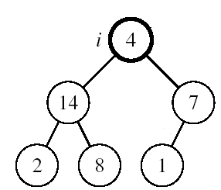
Maintaining the Heap Property
Suppose a node is smaller than a child
  Left and Right subtrees of i are max-heaps
To eliminate the violation:
  Exchange with larger child
  Move down the tree
  Continue until node is not smaller than children

Slide 12
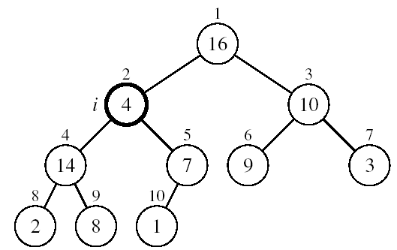
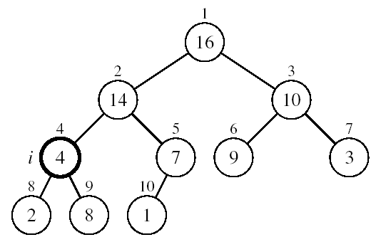
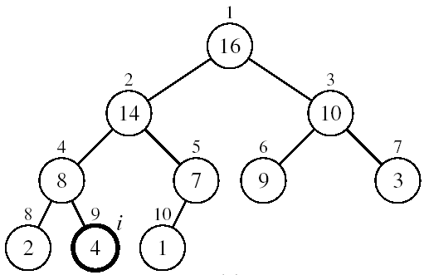
Example
MAX-HEAPIFY(A, 2, 10)
A[2] ↔ A[4]
A[2] violates the heap property
A[4] violates the heap property
A[4] ↔ A[9]
Heap property restored

Slide 13
Maintaining the Heap Property
Alg: MAX-HEAPIFY(A, i, n)
l ← LEFT(i)
r ← RIGHT(i)
if l ≤ n and A[l] > A[i]
then largest ←l
else largest ←i
if r ≤ n and A[r] > A[largest]
then largest ←r
if largest ≠ i
then exchange A[i] ↔ A[largest]
MAX-HEAPIFY(A, largest, n)
Assumptions:
  Left and Right subtrees of i are max-heaps
  A[i] may be smaller than its children

Slide 14
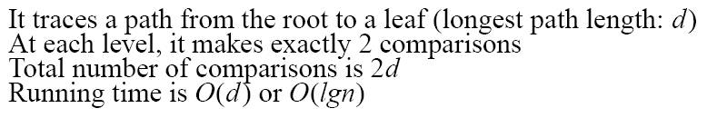
MAX-HEAPIFY Running Time
Intuitively:
Running time of MAX-HEAPIFY is O(lgn)
Can be written in terms of the height of the heap, as being O(h)
  Since the height of the heap is ⎣lgn⎦
-
h
-
-
-
2h
O(h)

Slide 15
Building a Heap
Convert an array A[1 … n] into a max-heap (n = length[A])
The elements in the subarray A[(⎣n/2⎦+1) .. n] are leaves
Apply MAX-HEAPIFY on elements between 1 and ⎣n/2⎦
Alg: BUILD-MAX-HEAP(A)
n = length[A]
for i ← ⎣n/2⎦ downto 1
do MAX-HEAPIFY(A, i, n)
1
4
2
3
1
3
4
5
6
7
2
16
9
10
8
9
10
14
8
7
A:
4 | 1 | 3 | 2 | 16 | 9 | 10 | 14 | 8 | 7

Slide 16
Example: A
4 | 1 | 3 | 2 | 16 | 9 | 10 | 14 | 8 | 7
i = 5
i = 4
i = 3
1
1
1
4
4
4
2
3
2
3
2
3
1
3
1
3
1
3
4
5
6
7
4
5
6
7
4
5
6
7
2
16
9
10
2
16
9
10
14
16
9
10
8
9
10
8
9
10
8
9
10
14
8
7
14
8
7
2
8
7
i = 2
i = 1
1
1
1
4
4
16
2
3
2
3
2
3
1
10
16
10
14
10
4
5
6
7
4
5
6
7
4
5
6
7
14
16
9
3
14
7
9
3
8
7
9
3
8
9
10
8
9
10
8
9
10
2
8
7
2
8
1
2
4
1

Slide 17
Running Time of BUILD MAX HEAP
Alg: BUILD-MAX-HEAP(A)
n = length[A]
for i ← ⎣n/2⎦ downto 1
do MAX-HEAPIFY(A, i, n)
O(n)
O(lgn)
⇒ Running time: O(nlgn)
This is not an asymptotically tight upper bound

Slide 18
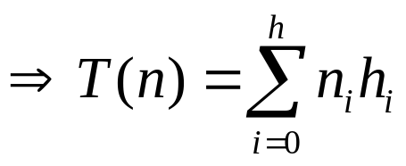
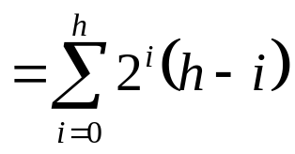

Running Time of BUILD MAX HEAP
HEAPIFY takes O(h) ⇒ the cost of HEAPIFY on a node i is proportional to the height of the node i in the tree
Height
Level
No. of nodes
h₀ = 3 (⎣lgn⎦)
i = 0
2⁰
h₁ = 2
i = 1
2¹
h₂ = 1
i = 2
2²
h₃ = 0
i = 3 (⎣lgn⎦)
2³
h_{i} = h – i height of the heap rooted at level i
n_{i} = 2^{i} number of nodes at level i

Slide 19
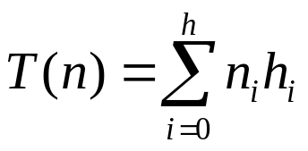
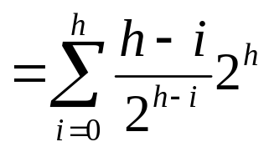

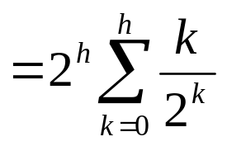
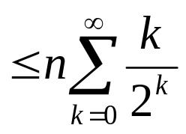
Running Time of BUILD MAX HEAP
Cost of HEAPIFY at level i ∗ number of nodes at that level
Replace the values of n_{i} and h_{i} computed before
Multiply by 2^{h} both at the nominator and denominator and
write 2^{i} as
Change variables: k = h - i
The sum above is smaller than the sum of all elements to ∞
and h = lgn
The sum above is smaller than 2
Running time of BUILD-MAX-HEAP: T(n) = O(n)

Slide 20
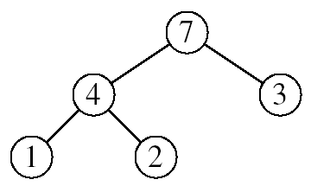
Heapsort
Goal:
  Sort an array using heap representations
Idea:
  Build a max-heap from the array
  Swap the root (the maximum element) with the last element in the array
  “Discard” this last node by decreasing the heap size
  Call MAX-HEAPIFY on the new root
  Repeat this process until only one node remains

Slide 21
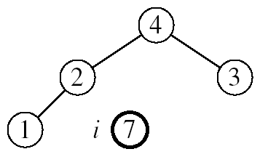
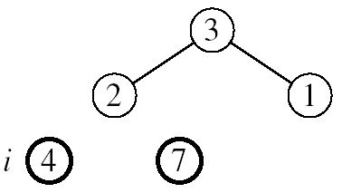
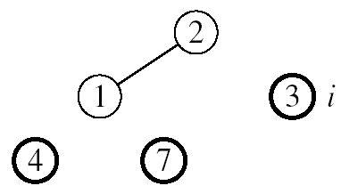
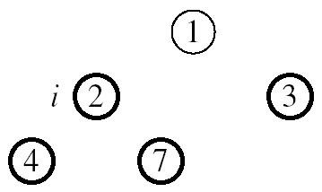

Example: A=[7, 4, 3, 1, 2]
MAX-HEAPIFY(A, 1, 4)
MAX-HEAPIFY(A, 1, 3)
MAX-HEAPIFY(A, 1, 2)
MAX-HEAPIFY(A, 1, 1)

Slide 22
Alg: HEAPSORT(A)
BUILD-MAX-HEAP(A)
for i ← length[A] downto 2
do exchange A[1] ↔ A[i]
MAX-HEAPIFY(A, 1, i - 1)
Running time: O(nlgn) --- Can be shown to be Θ(nlgn)
O(n)
n-1 times
O(lgn)

Slide 23
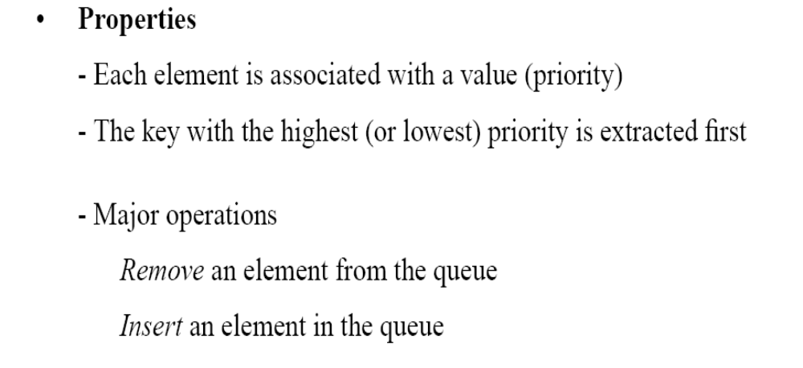
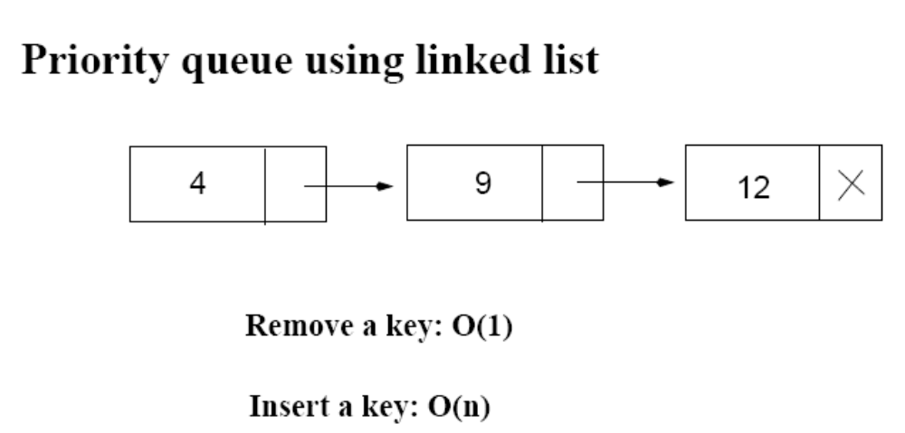
Priority Queues
12
4

Slide 24
Operations on Priority Queues
Max-priority queues support the following operations:
  INSERT(S, x): inserts element x into set S
  EXTRACT-MAX(S): removes and returns element of S with largest key
  MAXIMUM(S): returns element of S with largest key
  INCREASE-KEY(S, x, k): increases value of element x’s key to k (Assume k ≥ x’s current key value)

Slide 25
HEAP-MAXIMUM
Goal:
  Return the largest element of the heap
Alg: HEAP-MAXIMUM(A)
return A[1]
Running time: O(1)
Heap A:
Heap-Maximum(A) returns 7

Slide 26
HEAP-EXTRACT-MAX
Goal:
  Extract the largest element of the heap (i.e., return the max value and also remove that element from the heap
Idea:
  Exchange the root element with the last
  Decrease the size of the heap by 1 element
  Call MAX-HEAPIFY on the new root, on a heap of size n-1
Heap A:
Root is the largest element

Slide 27
Example: HEAP-EXTRACT-MAX
16
1
14
10
max = 16
14
10
8
7
9
3
8
7
9
3
2
4
1
2
4
Heap size decreased with 1
14
Call MAX-HEAPIFY(A, 1, n-1)
8
10
4
7
9
3
2
1

Slide 28
HEAP-EXTRACT-MAX
Alg: HEAP-EXTRACT-MAX(A, n)
if n < 1
then error “heap underflow”
max ← A[1]
A[1] ← A[n]
MAX-HEAPIFY(A, 1, n-1) remakes heap
return max
Running time: O(lgn)

Slide 29
HEAP-INCREASE-KEY
Goal:
  Increases the key of an element i in the heap
Idea:
  Increment the key of A[i] to its new value
  If the max-heap property does not hold anymore: traverse a path toward the root to find the proper place for the newly increased key
16
14
10
8
i
7
9
3
Key [i] ← 15
2
4
1

Slide 30
Example: HEAP-INCREASE-KEY
16
16
14
10
14
10
8
i
7
9
3
8
i
7
9
3
2
4
1
2
15
1
Key [i ] ← 15
16
16
i
14
10
15
10
i
15
7
9
3
14
7
9
3
2
8
1
2
8
1

Slide 31
HEAP-INCREASE-KEY
Alg: HEAP-INCREASE-KEY(A, i, key)
if key < A[i]
then error “new key is smaller than current key”
A[i] ← key
while i > 1 and A[PARENT(i)] < A[i]
do exchange A[i] ↔ A[PARENT(i)]
i ← PARENT(i)
Running time: O(lgn)
16
14
10
8
i
7
9
3
2
4
1
Key [i] ← 15

Slide 32
MAX-HEAP-INSERT
Goal:
  Inserts a new element into a max-heap
Idea:
  Expand the max-heap with a new element whose key is -∞
  Calls HEAP-INCREASE-KEY to set the key of the new node to its correct value and maintain the max-heap property
16
14
10
8
7
9
3
2
4
1
-∞
16
14
10
8
7
9
3
2
4
1
15

Slide 33
Example: MAX-HEAP-INSERT
Insert value 15:
- Start by inserting -∞
Increase the key to 15
Call HEAP-INCREASE-KEY on A[11] = 15
16
16
14
10
14
10
8
7
9
3
8
7
9
3
2
4
1
-∞
2
4
1
15
The restored heap containing
the newly added element
16
16
14
10
15
10
8
15
9
3
8
14
9
3
2
4
1
7
2
4
1
7

Slide 34
MAX-HEAP-INSERT
Alg: MAX-HEAP-INSERT(A, key, n)
heap-size[A] ← n + 1
A[n + 1] ← -∞
HEAP-INCREASE-KEY(A, n + 1, key)
16
14
10
8
7
9
3
2
4
1
-∞
Running time: O(lgn)

Slide 35
Summary
We can perform the following operations on heaps:
  MAX-HEAPIFY O(lgn)
  BUILD-MAX-HEAP O(n)
  HEAP-SORT O(nlgn)
  MAX-HEAP-INSERT O(lgn)
  HEAP-EXTRACT-MAX O(lgn)
  HEAP-INCREASE-KEY O(lgn)
  HEAP-MAXIMUM O(1)
Average
O(lgn)

Slide 36
Priority Queue Using Linked List
12
4
Average: O(n)
Increase key: O(n)
Extract max key: O(1)

Slide 37
Problems
Assuming the data in a max-heap are distinct, what are the possible locations of the second-largest element?

Slide 38
Problems
(a) What is the maximum number of nodes in a max heap of height h?
(b) What is the maximum number of leaves?
(c) What is the maximum number of internal nodes?

Slide 39
Problems
Demonstrate, step by step, the operation of Build-Heap on the array
A=[5, 3, 17, 10, 84, 19, 6, 22, 9]

Slide 40
Problems
Let A be a heap of size n. Give the most efficient algorithm for the following tasks:
Find the sum of all elements
Find the sum of the largest lgn elements

